Slide 1
Phishing Awareness Training
Recognizing and Avoiding Phishing Attacks
Presented by: Devang Pratap Singh Yadav

Slide 2

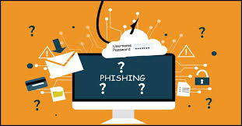
Introduction to Phishing
Phishing is a cyber-attack where attackers trick users into revealing sensitive information.
Commonly done via emails, fake websites, or messages.
Goal: Steal credentials, financial data, or install malware.

Slide 3

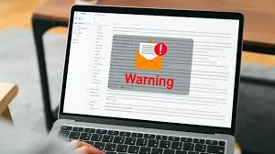
Email Phishing
Most common phishing attack.
Attackers send fraudulent emails pretending to be a trusted entity.
Often contains fake links or malicious attachments.
Example: An email pretending to be from a bank requesting login details.

Slide 4
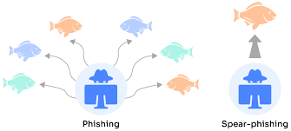
Spear Phishing
Targeted attack aimed at specific individuals or organizations.
Uses personal information to make the email seem legitimate.
Often used to gain access to company networks.
Example: A fake email from an IT department asking for login credentials.

Slide 5
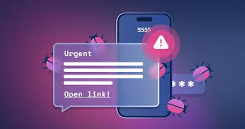
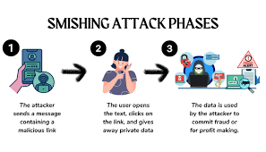
Smishing (SMS Phishing)
Phishing attack via text messages.
Attackers send fraudulent SMS containing malicious links.
Often claims to be from banks, delivery services, or government agencies.
Example: A fake message from a courier service with a tracking link leading to malware.

Slide 6
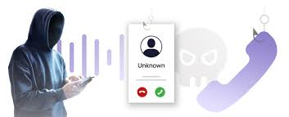
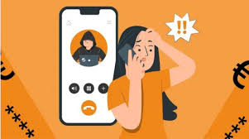
Vishing (Voice Phishing)
Phishing attack conducted over phone calls.
Attackers impersonate trusted organizations (banks, tech support, etc.).
Often use urgency or threats to trick victims.
Example: A scammer pretending to be from the IRS demanding immediate payment.

Slide 7
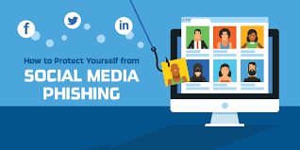

Social Media Phishing
Attackers use fake social media profiles or messages.
Trick users into clicking malicious links or revealing personal details.
Can spread malware or steal credentials.
Example: A fake friend request linking to a phishing website.

Slide 8
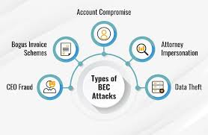
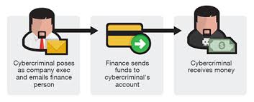
Business Email Compromise (BEC)
Attackers impersonate executives or business partners.
Used to manipulate employees into transferring money or data.
Often highly targeted and well-researched.
Example: A fake email from the CEO requesting urgent wire transfers.

Slide 9
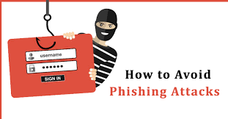
How to Avoid Phishing Attacks
Verify sender emails and links.
Use Two-Factor Authentication (2FA).
Report suspicious emails to IT/security teams.
Keep software and antivirus updated.
Educate yourself and others on phishing tactics.

Slide 10
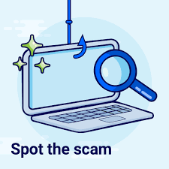
Quiz: Spot the Phishing Email
→ Which of these emails is a phishing attempt Look for:
a) Suspicious links
b) Urgent language
c) Misspellings
d) Fake sender details

Slide 11
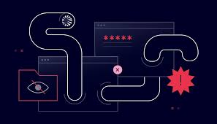
Conclusion & Best Practices
Always verify emails and URLs.
Never share sensitive information via email.
Report phishing attempts.
Stay updated on cybersecurity trends.
Think before you click!

